Slide 1
A deep dive into endoscopy
Learn more about recommendations for endoscopy in patients with eosinophilic esophagitis (EoE)
Developed in collaboration with
Professor Seema Aceves, Rady Children’s Hospital, University of California, San Diego, CA, USA;
Professor Arjan Bredenoord, Amsterdam University Medical Center and the University of Amsterdam, Netherlands
Professor Evan Dellon, University of North Carolina, Chapel Hill, NC, USA

Slide 2

The diagnosis of EoE includes clinical assessment, endoscopy/histology and the exclusion of other disorders
Three-step criteria for diagnosis¹
Identification of esophageal
dysfunction symptoms
Endoscopic/histological
assessment^{1–3}
Evaluation of
non-EoE disorders¹
Infants and young children^{1,3}
Selective eating or feeding intolerance
Poor growth and/or failure to thrive
Reflux-like symptoms
Older children^{1,3}
Abdominal pain
Vomiting
Regurgitation
Heartburn
Adolescents and adults^{1,2}
Dysphagia*
Food impaction*
Adaptive eating behaviors (IMPACT)†
Heartburn, chest pain or discomfort
Exclude other disorders that can potentially cause or contribute to esophageal eosinophilia
Such disorders include: GERD, HES, non-EoE EGIDs, achalasia, Crohn’s disease, pill esophagitis, drug hypersensitivity reactions, infections, connective tissue or autoimmune diseases
Endoscopy
Findings (eg Edema, Rings, Exudates, Furrows and Strictures) should be evaluated using EoE Endoscopic Reference Score (EREFS)
Histology
EoE diagnosis requires esophageal biopsies demonstrating at least 15 eos/hpf
At least six biopsies from at least two esophageal levels are recommended
*Symptoms of esophageal dysfunction, such as dysphagia to solid foods and food impaction are hallmark indicators of the disease^{2,3}
†The IMPACT acronym denotes adaptive eating behaviors: Imbibe fluids; Modify food; Prolong mealtimes; Avoid hard texture foods; Chew excessively; Turn away tablets/pills¹
EGIDs, eosinophilic gastrointestinal disorders; EoE, eosinophilic esophagitis; eos/hpf, eosinophils per high-powered field; EREFS, eosinophilic esophagitis endoscopic reference score; GERD, gastroesophageal reflux disease; HES, hypereosinophilic syndrome
1. Dellon ES, et al. Am J Gastroenterol. 2025;120:31–59; 2. Farah A, et al. Diagnostics (Basel). 2025;15:240; 3. de Bortoli N, et al. Dig Liver Dis. 2024;56:951–963.

Slide 3
Endoscopy in EoE
An esophageal examination is critical for the diagnosis of EoE and to
assess treatment response^{1,2}
Endoscopic findings alone are
not a reliable predictor of EoE, especially in children³
The presence or absence of EoE features should be recorded with
EREFS at each endoscopy^{1,4–6}
Studies have shown that in patients undergoing upper endoscopy, those with symptoms of esophageal dysfunction were then diagnosed with EoE based on endoscopic findings
  Between 12–23% of patients underwent endoscopy due to dysphagia
  Over 50% of patients underwent endoscopy due to esophageal food
  bolus impaction
In children, a significant proportion
will present with a macroscopically normal esophagus; in a meta-analysis
of 1015 patients with EoE, 21% of children had a macroscopically
normal esophagus
Taking a biopsy is essential for accurate diagnosis
EREFS identifies and grades the severity of the common, reproducible and identifiable endoscopic features
The findings from EREFS have been found to discriminate EoE from other conditions with high accuracy
EoE, eosinophilic esophagitis; EREFS, endoscopic reference score
1. Dellon ES. Clin Gastroenterol Hepatol. 2021;19:2489–2492.e1; 2. Dellon ES, Hirano I. Gastroenterology. 2018;154:319–332; 3. Dhar A, et al.
Gut. 2022;71:1459–1487; 4. Ahuja N, et al. J Pediatr Gastoenterol Nutr. 2020;71:328–332; 5. Kia L, Hirano I. Curr Opin Gastroenterol. 2016;32:325–311;
6. Dellon ES, et al. Am J Gastroenterol. 2025;120:31–59.

Slide 4
The EREFS allows quantified assessment and grading of the major endoscopic features of EoE^{1–3}
EREFS identifies and grades the severity of the following common, reproducible and identifiable endoscopic features:^{1*}
Grade 0
Grade 1
Grade 2
Grade 3
Edema
(loss of vascular markings)
Distinct vascularity
Present
Decreased vascularity
Rings
(trachealization)
None
Mild
Ridges
Moderate Distinct rings
Severe
Scope cannot pass
Exudate
(with plaques)
None
Mild
≤10% surface area
Severe
>10% surface area
Furrows
(vertical lines)
None
Mild
Severe
With appreciable depth
Stricture
Absent
Present
*EREFS scores five endoscopic features using the worst appearing area, giving a total score of 0–9 per esophageal segment³
EREFS, endoscopic reference score; EoE, eosinophilic esophagitis
1. Ahuja N, et al. J Pediatr Gastoenterol Nutr. 2020;71:328–332; 2. Kia L, Hirano I. Curr Opin Gastroenterol. 2016;32:325–311; 3. Dellon ES, et al. Am J Gastroenterol. 2025;120:31–59.

Slide 5
General recommendations for endoscopy
Diagnosis of EoE should be based on endoscopic and histological assessments
Refer patients to gastroenterology for endoscopy if the patient presents with symptoms suggestive of EoE or
an emergency presentation with
food bolus obstruction
At least six esophageal biopsies from at least two esophageal levels (eg proximal/ mid and distal) are recommended
Diagnosis requires esophageal biopsies showing at least 15 eos/hpf
(or ≥15 EOS/0.3 mm² or >60 EOS/mm²),
in the absence of other causes of esophageal eosinophilia
For an accurate diagnosis, PPIs should be withdrawn for at least 3 weeks prior to endoscopy*
*PPIs may prevent a definitive diagnosis of EoE, through suppression of esophageal eosinphils below the diagnostic threshold
EoE, eosinophilic esophagitis; EOS, eosinophils; eos/hpf, eosinophils per high-powered field; PPIs, proton-pump inhibitors
Dhar A, et al. Gut. 2022;71:1459–1487.

Slide 6
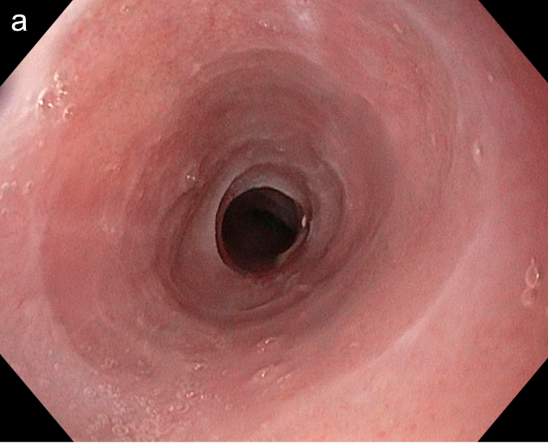
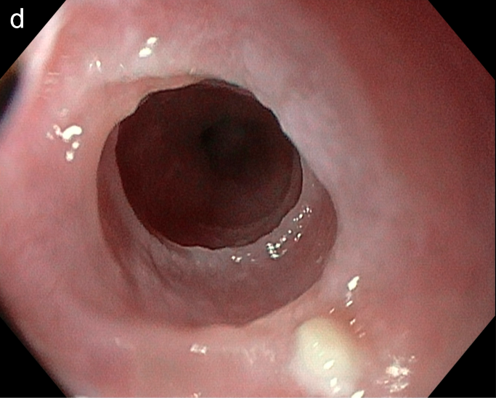
Current recommendations for endoscopy in EoE
Adult patients¹
Repeat endoscopies and esophageal biopsies should be
considered in all patients where there is a high suspicion of an
EoE diagnosis, but whose initial histology was not diagnostic¹
All adult patients undergoing endoscopy should have esophageal biopsies taken if:
  They have endoscopic signs associated with EoE
  Symptoms of dysphagia or food bolus obstruction, with a normal-looking esophagus
Patients with food bolus obstruction should receive an urgent referral for an endoscopy, or as an emergency, depending on the clinical presentation
Endoscopic features of EoE, including edema, strictures and narrowing, can be difficult to detect and assess during endoscopy, particularly
if not severe^{2,3}
Endoscopist should look for subtle findings during the procedure, using EREFS to identify and grade the key endoscopic features of EoE^{2,4–6}
Pediatric patients¹
Due to the non-specific presenting symptoms of EoE in children, all children with upper gastrointestinal symptoms requiring an endoscopy should have esophageal biopsies taken to potentially diagnose EoE
Endoscopy and biopsies should be undertaken to exclude EoE
in children with symptoms of GERD who are refractory to PPIs*
Patient with edema (characterized by
loss of vascular pattern) and rings⁷
Patient with edema and rings causing narrowing of the esophagus (stricture)⁷
Images available from Michelon M, et al. Allergies. 2025;5:17
*This is not a recommendation in adult patients because of the low prevalence of EoE in these patients
EoE, eosinophilic esophagitis; EREFS, endoscopic reference score; GERD, gastroesophageal reflux disease; PPI, proton pump inhibitor
1. Dhar A, et al. Gut. 2022;71:1459–1487; 2. Dellon ES. Clin Gastroenterol Hepatol. 2021;19:2489–2492.e1; 3. Canakis A, Dellon ES. Dis Esophagus. 2025;38:doaf045;
4. Ahuja N et al. J Pediatr Gastoenterol Nutr. 2020;71:328–332; 5. Kia L, Hirano I. Curr Opin Gastroenterol. 2016;32:325–311; 6. Dellon ES. Am J Gastroenterol. 2025;120:31–59;
7. Michelon M, et al. Allergies. 2025;5:17.
Notes:
Copyright: images available under CC-BY-4.0 (https://creativecommons.org/licenses/by/4.0/)

Slide 7
Considerations when performing endoscopy
The following recommendations should be considered for an optimal examination of the esophagus
and accurate monitoring of endoscopic features of EoE¹
Allow sufficient time at each endoscopy to fully assess and photograph all findings¹
The presence or absence of all findings should be recorded using EREFS at each endoscopy to qualify the severity of disease¹
It is important to carry out a careful endoscopy, with full insufflation and washing of debris, including saliva, mucous and blood¹
  Full insufflation allows for the accurate assessment and recording of the EREFS; insufficient insufflation and clearance of saliva or other debris can obscure
  EoE-related findings and hinder the evaluation of strictures^{1,2}
  The esophagus should be fully examined on insertion of the scope, before the upper examination is completed; advancing the endoscope or performing
  therapeutics too early can falsify the EREFS¹
An assessment should also be made for signs of fibrostenosis at each endoscopy¹
  Strictures are commonly missed in patients with EoE during endoscopy, with a low sensitivity (25%) in recognizing diameters of
  less than 15 mm compared with barium esophagrams; PICK-UP-STRICS score can be used to aid clinical suspicion of EoE²*
  Other signs that could indicate the presence of strictures include the sensation of resistance of the scope during the examination and the passage of the endoscope
  over an unidentified stricture causing mucosal trauma, which should prompt reassessment²
  If a regular upper endoscope can pass without resistance or mucosal trauma, this indicates an esophageal diameter of 9–10 mm at minimum²
  Esophageal distensibility can be measured using an endoluminal functional lumen imaging probe (EndoFLIP). This has been found to have increased sensitivity for detecting fibrotic changes (eg strictures and distensibility) in the esophagus and should be considering when assessing for signs of fibrostenosis³
*PICK-UP-STRICS score can be used to help predict which patients may have strictures prior to endoscopy and is made up of the following clinical factors: age, symptom length prior to EoE diagnosis, presence or absence of dysphagia, food impaction, or abdominal pain²
EoE, eosinophilic esophagitis; EREFS, endoscopic reference score
1. Dellon ES. Clin Gastroenterol Hepatol. 2021;19:2489–2492.e1; 2. Canakis A, Dellon ES. Dis Esophagus. 2025;38:doaf045; 3. Dellon ES. Am J Gastroenterol. 2025;120:31–59.

Slide 8
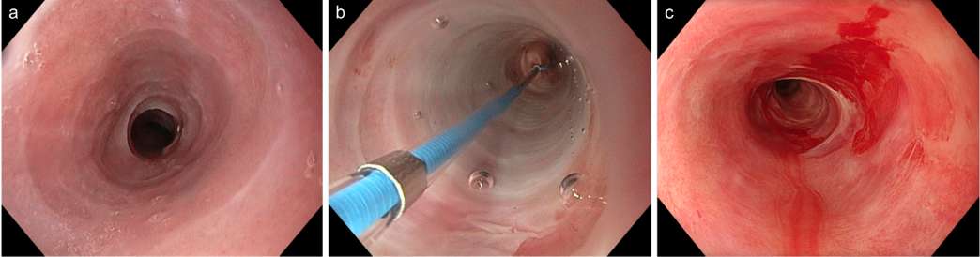
Importance of dilation in the management of fibrostenotic EoE
Management of fibrostenotic EoE¹
Endoscopic dilation procedure²
Following stricture identification
  Dilation with a bougie or balloon can be pursued based on operator experience, stricture characteristics and goals of dilation
  Progressively larger dilator sizes should be pursued until there is a good dilation effect (ie an intentional mucosal disruption); a diameter of 16–18 mm should be achieved but this may take several sessions to achieve
  If no obvious stricture is identified but clinical suspicion remains high, cautious dilation, working up to 16–18 mm, can be pursued
If used in appropriately selected patients and combined with
anti-inflammatory medication, endoscopic dilation can offer
improvements in dysphagia
  However, several procedures may be needed, and post-dilation discomfort is experienced in the majority of patients
a
b
c
a) Endoscopic image of EoE, showing edema, rings and stenosis of the esophagus
b) Endoscopic dilation performed
with a multi-size dilation balloon
c) Esophageal mucosal tearing, indicating the effectiveness of
the dilation
Images available from Michelon M, et al. Allergies. 2025;5:17
EoE, eosinophilic esophagitis
1. Canakis A, Dellon ES. Dis Esophagus. 2025;38:doaf045; 2. Michelon M, et al. Allergies. 2025;5:17.
Notes:
Copyright: images available under CC-BY-4.0 (https://creativecommons.org/licenses/by/4.0/)

